Slide 1
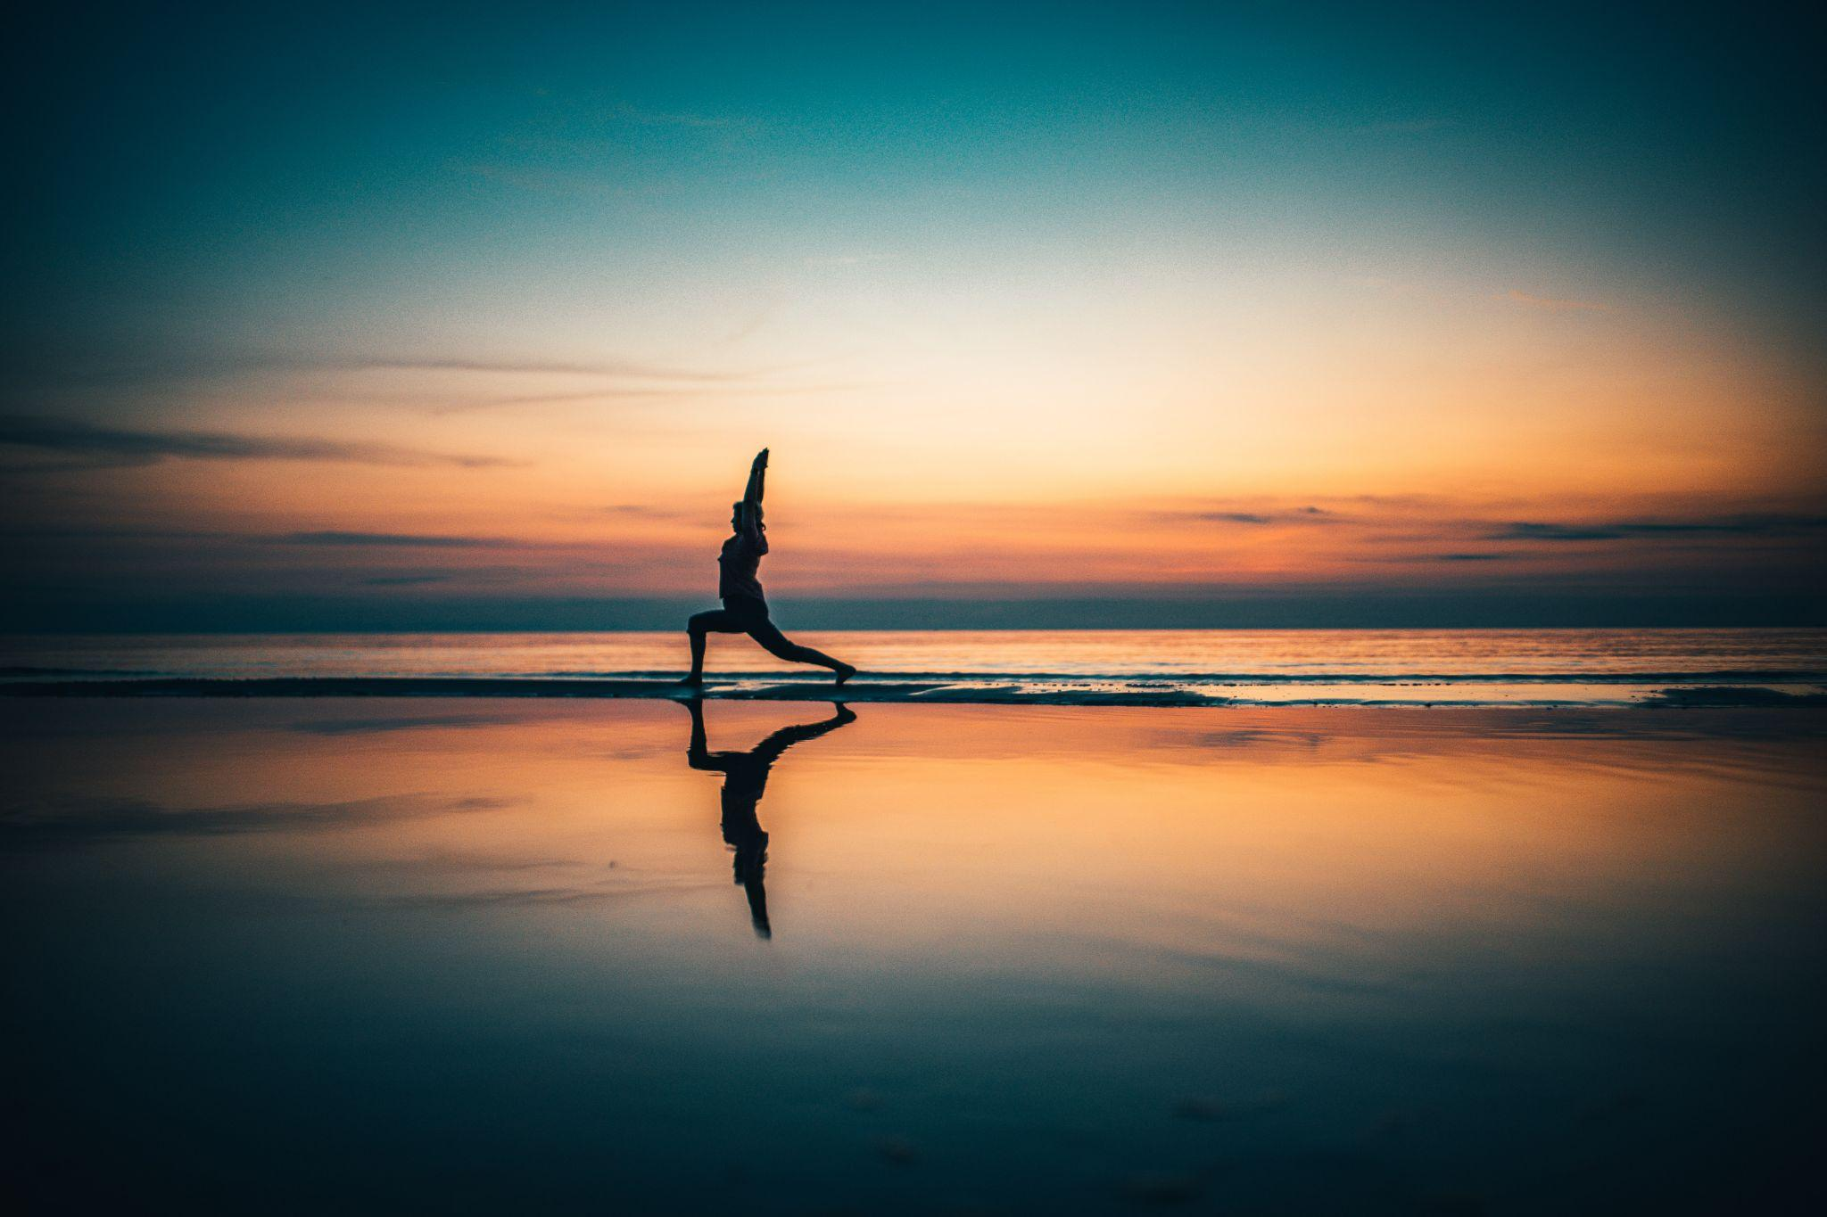

YoPo
Term Evaluation of Minor Project
Under the Guidance of : Dr. Mantosh Biswas
By:
Gyan Ujjwal 2020UGCS001
K. Hemanth Naik 2020UGCS013
Akhilesh Kumar Mishra 2020UGCS053

Slide 2
Overview
YoPo
This will be a Yoga Pose Detector that will work as a personal trainer in which a person can perform different exercises and our model will detect the correct posture for that yoga pose and calculate the best time via live image processing technique.

Slide 3
Understanding the problems
Everyone can not afford a personal trainer to perform the daily yoga activities.
+
Without guidance most of the people are performing wrong yoga postures. Doing correct Yoga posture can only benefits a person.
+

Slide 4
Objective
To detect major flexion points of human body
Classification of frame data into different yoga poses
Live feed capture and detection of pose and movement
Accuracy measurement of yoga pose in real time.

Slide 5
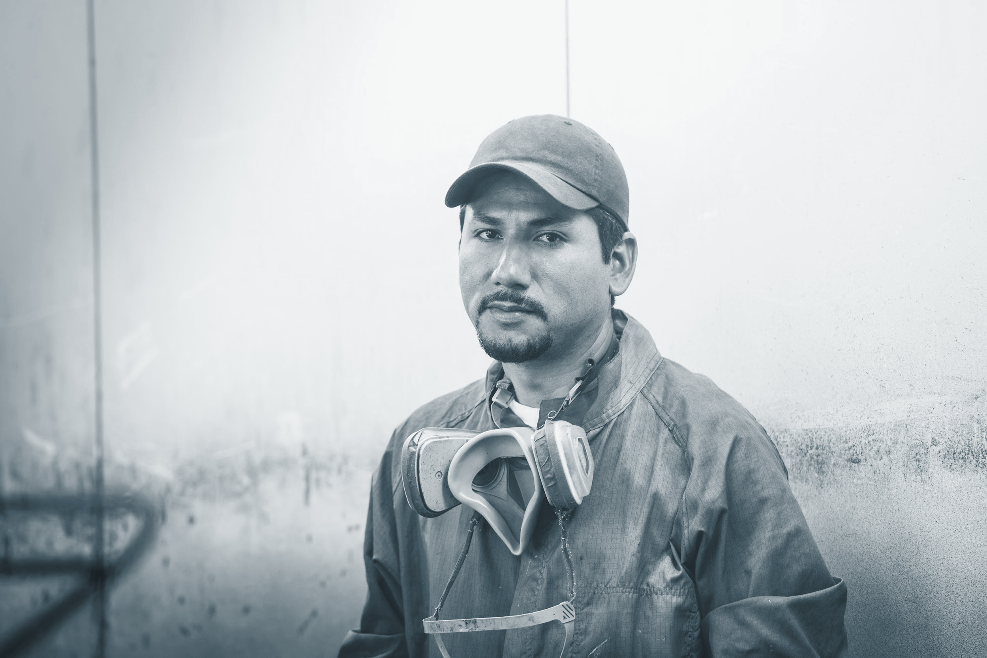
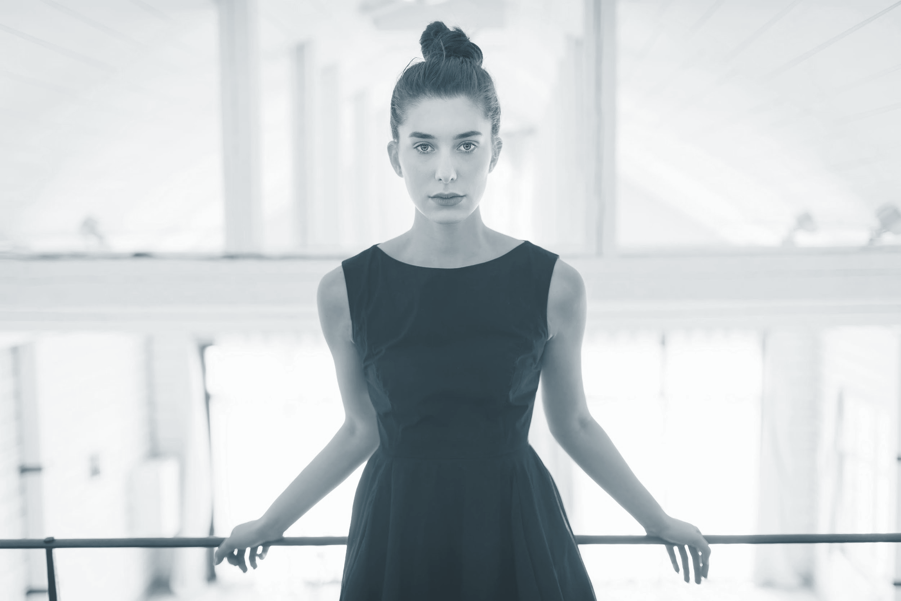
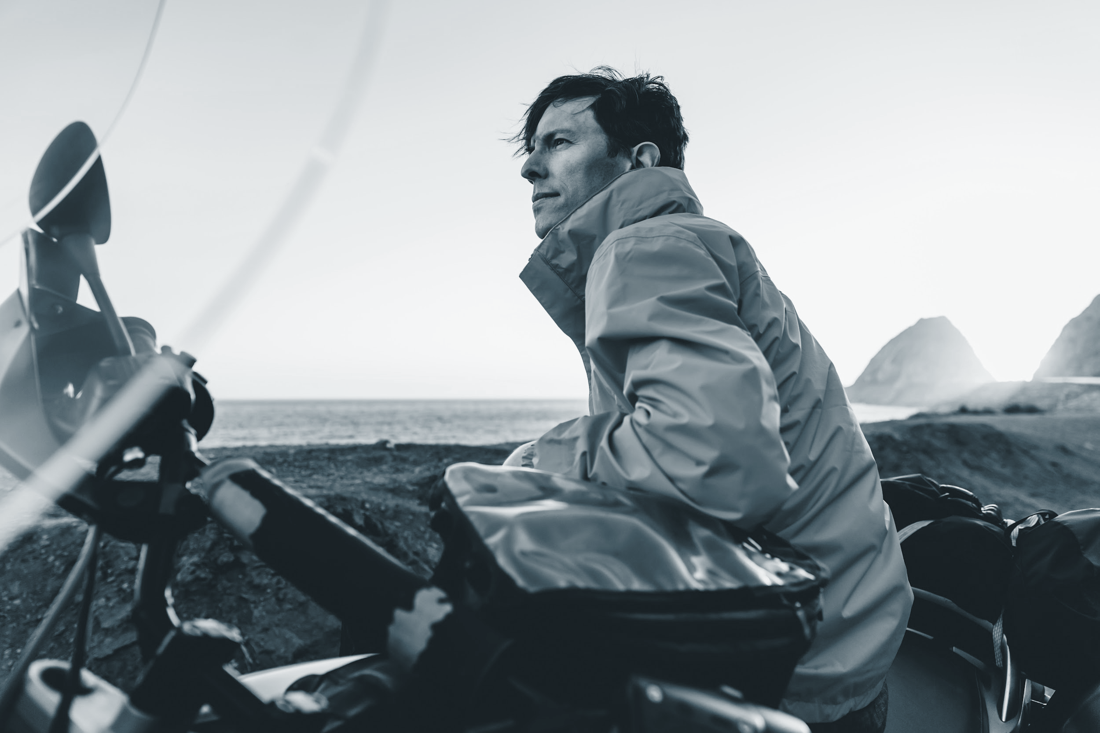
Target audience
Yoga Enthusiast
Age : 16 to 70
Physiotherapy patients
Anxiety patients
Audience aiming for general Fitness

Slide 6
Software Requirements
Tensor Flow
Pandas
Numpy
Sklearn
OpenCV
ReactJs

Slide 7
Model Training
Input Image Data
Image Dataset has been passed for landmark detection.
Thunder MoveNet module is utilised to generate 14 landmarks.
New Landmarks are generated for centers of changes and the whole shape is transformed according to the image.
The trained weights are updated
Pose is classified to the classes using CNN and clustering and best weights are updated.
Landmark Detection
Landmark Transformation & Generation
Pose Classification
Fig 1: Training Model

Slide 8
Model testing and Validation
Input VideoData
Model imports the best weights evaluated during training.
Video image is divided into frames according to frame rate of webcam ( ~30fps).
Landmarks were detected and transformation and preprocessing to feed the landmarks into the model was done.
The classification of pose according to the testing pose parameters were done using CNN.
Comparison to best weights with the pose parameters is done to evaluate best pose time.
Framing
Landmark Detection
Landmarks Transformation & Generation
Pose Classification
Best Pose Evaluation
Fig 2: Testing & Validation Model

Slide 9
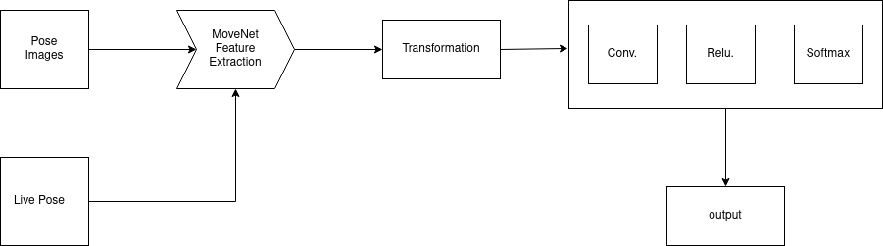
Control Flow of Our Proposed Model
Fig 3: Flow Model
This is the flow model of our Model in which we have shown the way our model is processing the images and generating the output.

Slide 10
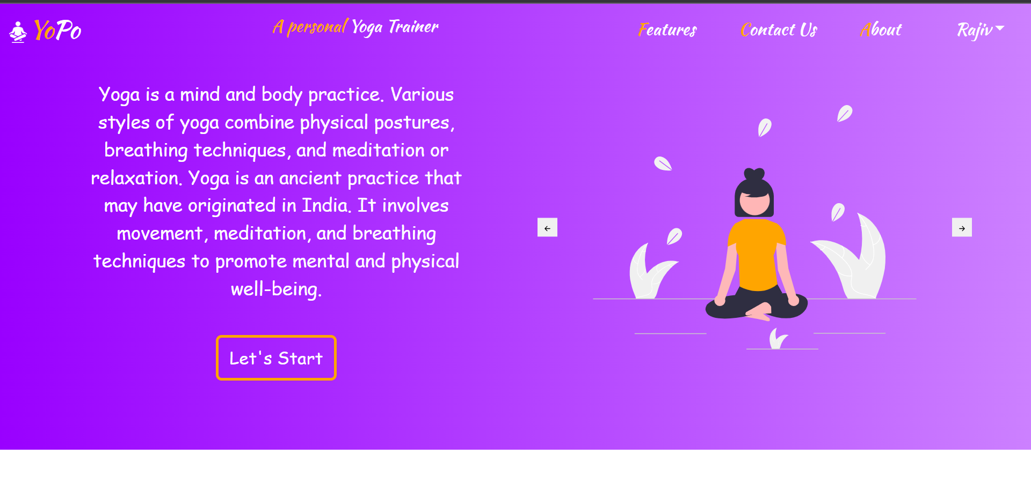
Our WebApp
Fig 4: Home page our WebApp

Slide 11
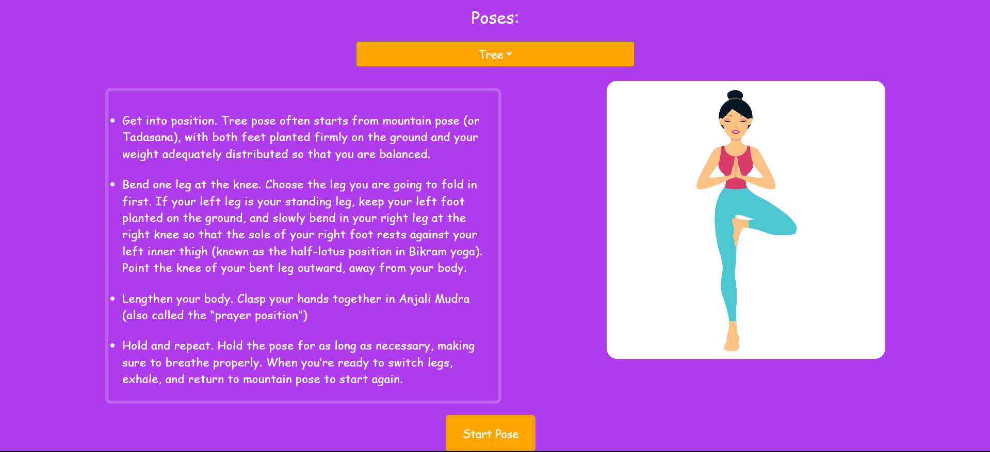
Fig 5 : /start Route of page consisting of various yoga poses, here Tree Pose

Slide 12
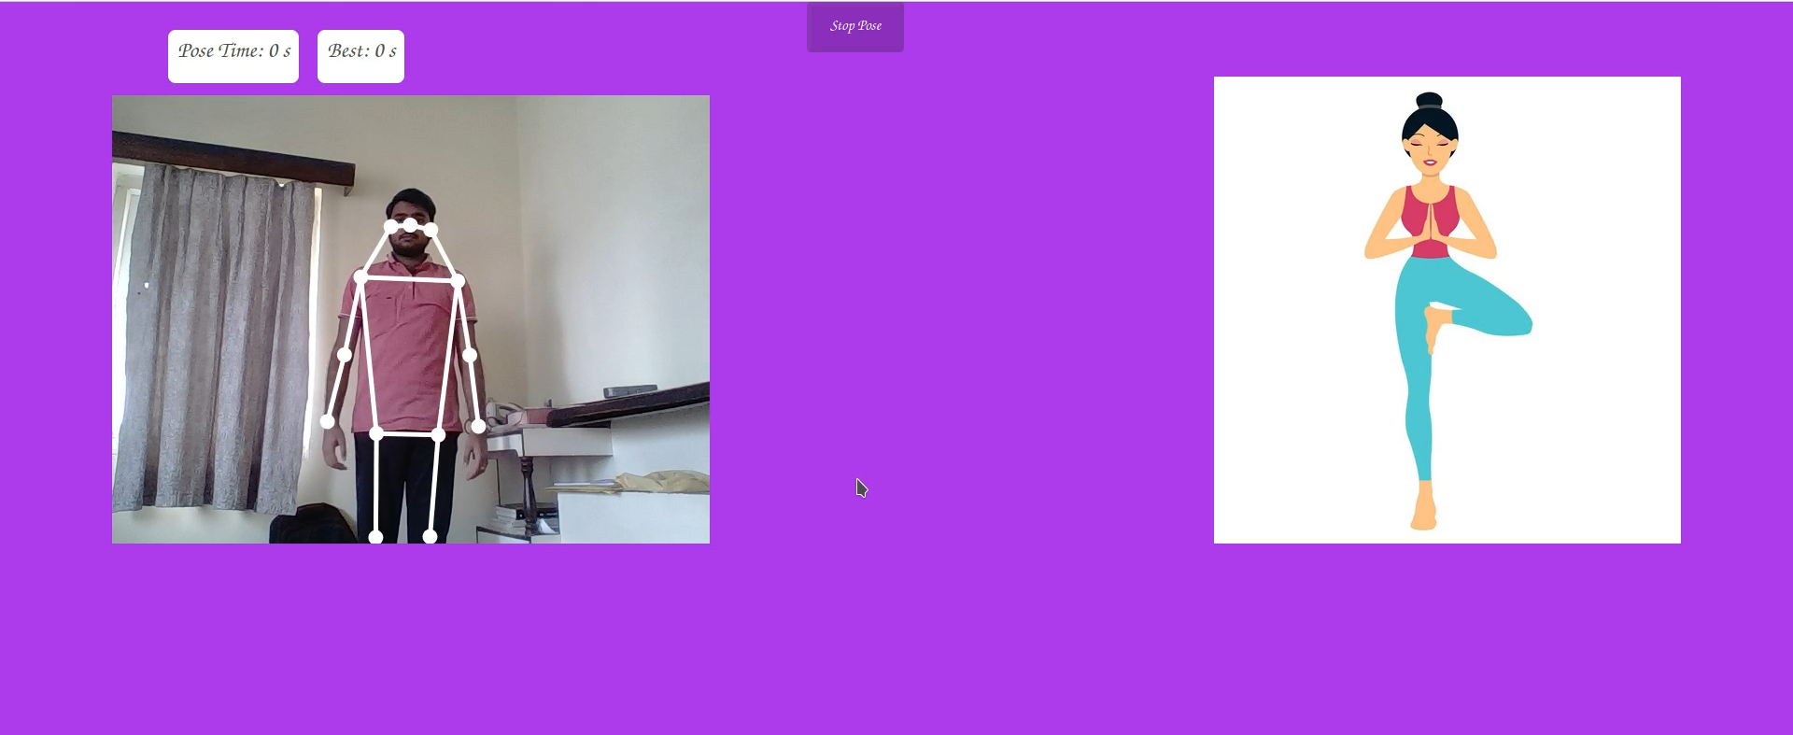
MovNet
A. Dots on Flexion
B. Yoga Illustrator
Fig 6: Here we can see that our model is creating the dots on the joints so that it can track the movement.

Slide 13
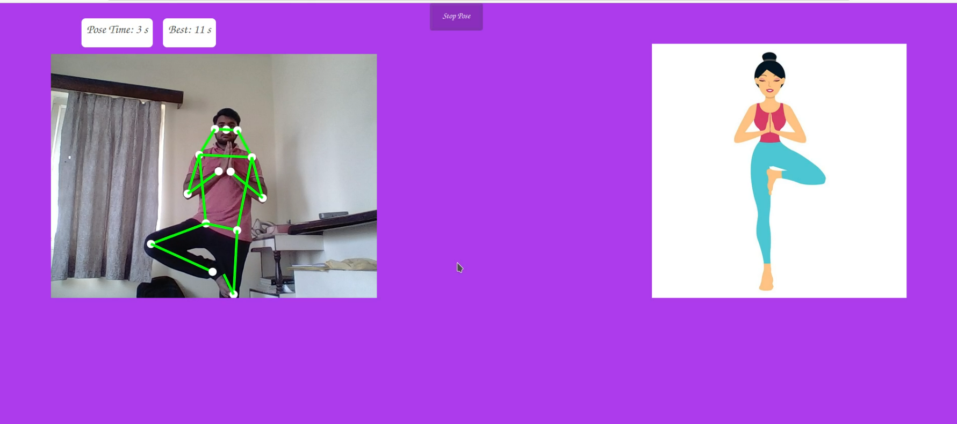
Tree Pose (Best Pose)
A. Green Dots on Flexion
B. Yoga Illustrator
Fig 7: Once the model detects the correct pose attend, dots will be green and the counter begins.

Slide 14
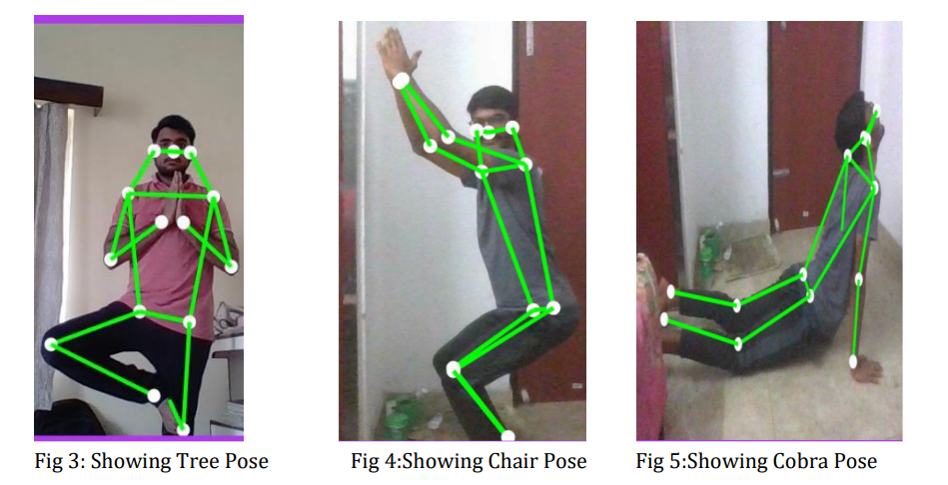
Other Poses
Fig 8:
Fig 9:
Fig 10:

Slide 15
Conclusion
Human pose estimation is different as it has to localize and assemble human body parts on the basis of an already defined structure of the human body.
Application of pose estimation in fitness and sports can help prevent injuries and improve the performance of people’s workout. suggests, yoga self instruction systems carry the potential to make yoga popular along with making sure it is performed in the right manner.

Slide 16
Team Contribution
Gyan Ujjwal | Worked on Machine Learning Part
K. Hemanth Naik | Worked on Research & Training of Model
Akhilesh Kumar Mishra | Worked on Web App Part

Slide 17
THANK YOU
THANK YOU

Slide 18
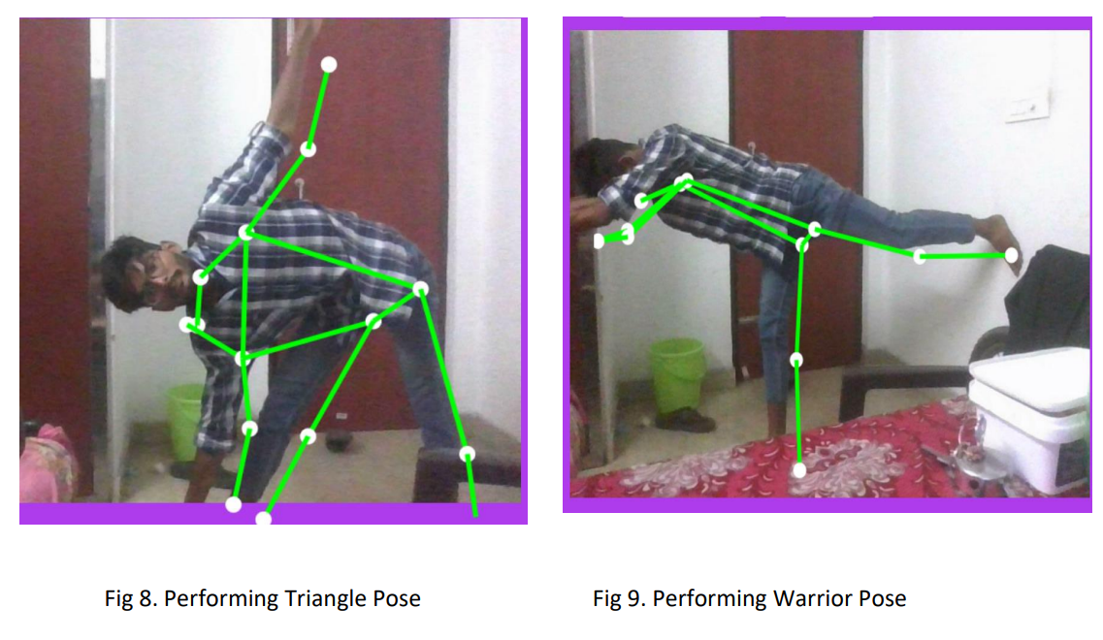
Continued..
Fig 13:
Fig 14:

Slide 19
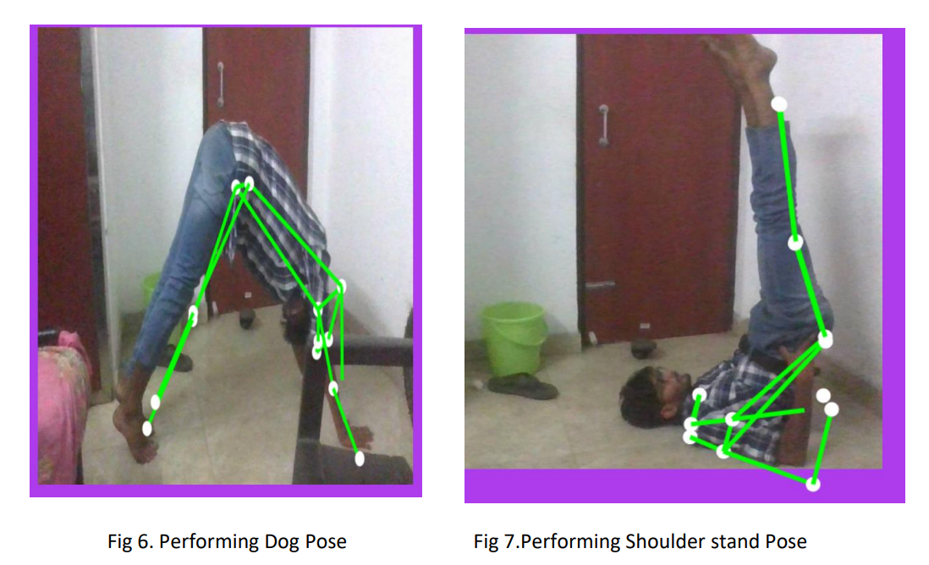
Continued…
Fig 11:
Fig 12:

